Slide 1
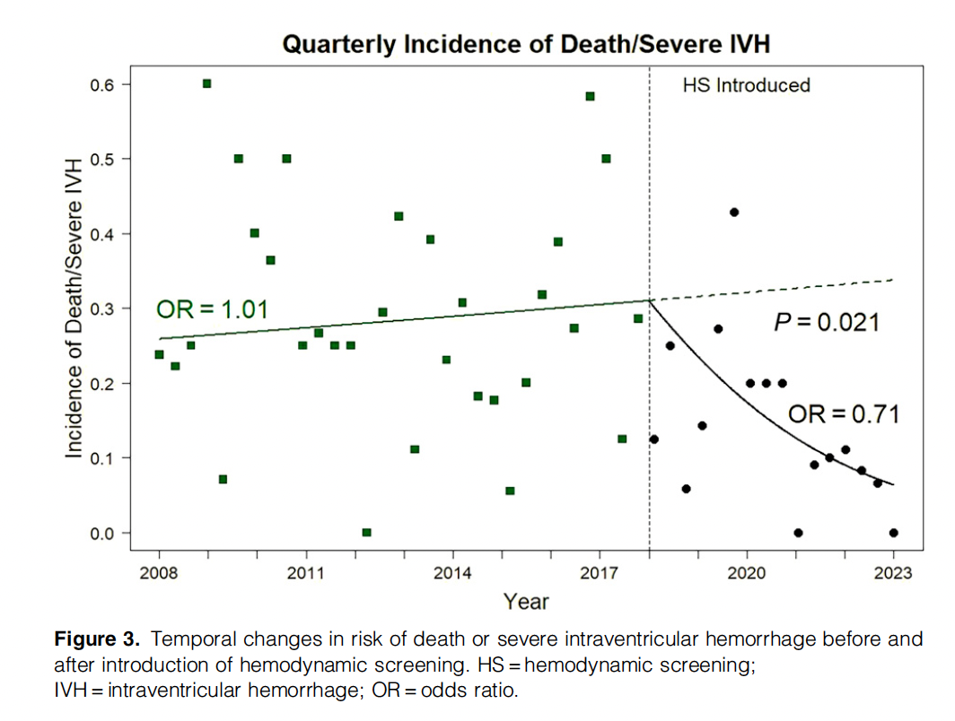
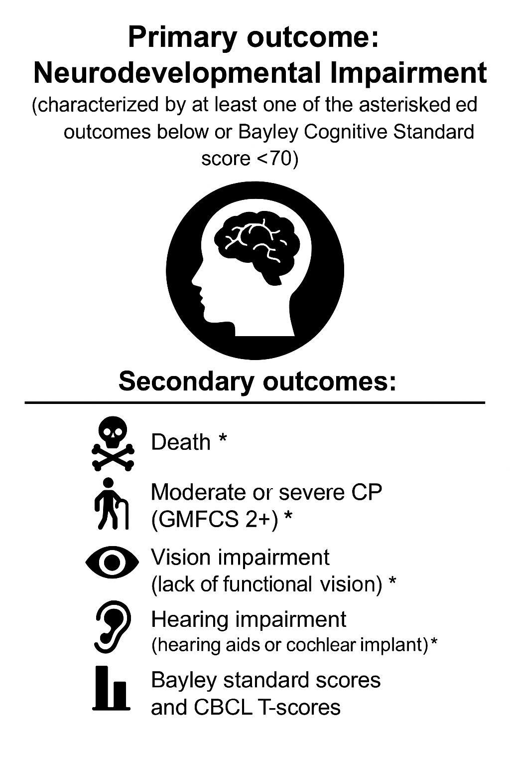
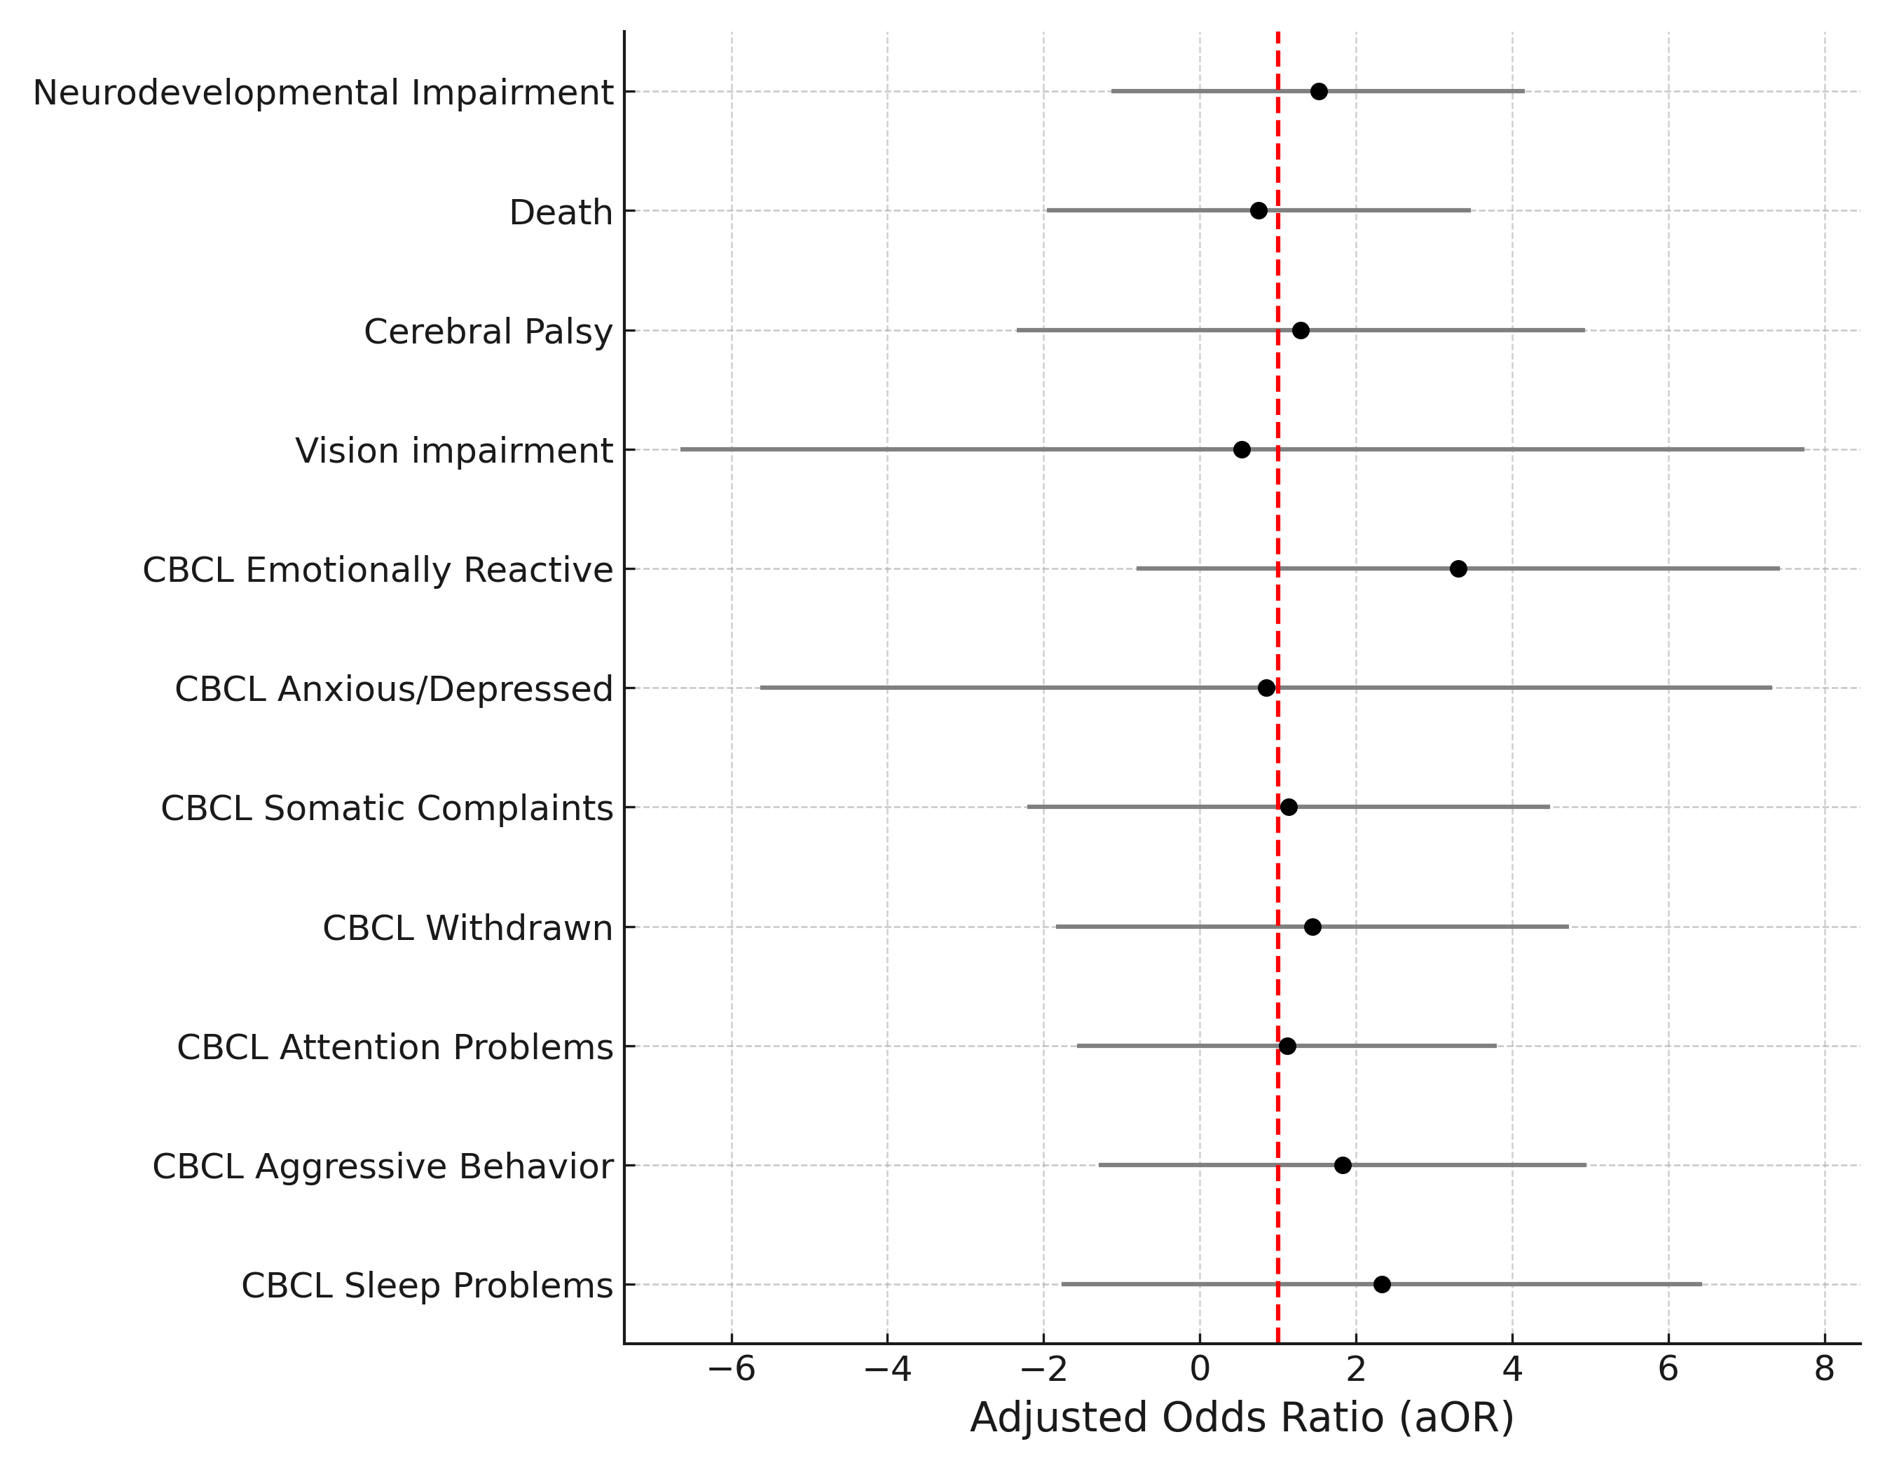
Impact of Early Hemodynamic Screening on Neurodevelopmental Outcomes of Extremely Preterm Infants in a High-Performance Center
Saffron E. McNamara, Heidi M. Harmon, MD, MS, Patrick J. McNamara, MD, MSc, Danielle R. Rios, MD, Allison M. Momany, PhD
Iowa Health Care Stead Family Children’s Hospital | Department of Pediatrics, Division of Neonatology
Introduction
Results
Summary
Implementation of a hemodynamic screening program (mandatory targeted neonatal echo 18-24 hours after birth) at University of Iowa for babies born <27 weeks gestational age was associated with a reduction in death & severe IVH¹
Table 1. Demographics and Clinical Characteristics
There was no significant difference in neurodevelopmental outcomes between the historical and hemodynamic cohorts.
The incidence of death or severe IVH was not reduced in the hemodynamic cohort as was observed in the original study.
There were significantly more infants born at 21-23 weeks in the hemodynamic epoch without an increase in IVH or neurodevelopmental impairments.
There was a trend (p = .056) toward less follow-up study visits completed in the hemodynamic cohort (25% vs. 15%). This likely reflects difficulties with follow-up visits during the pandemic.
Rehabilitation therapies, which play an important role in reducing the severity of neurodevelopmental impairment, were likely impacted by the pandemic as well.
 | Historical Epoch (n= 173) | Hemodynamic Epoch (n= 148) | P value
Gestational age, weeks | 24.4 (1.4) | 24.1 (1.5) | .07
Gestational age, 21-23 weeks | 47 (27%) | 63 (43%) | <.01
Birth weight (BW), grams | 719.2 (1.9) | 658.8 (1.8) | <.01
Sex, male | 84 (49%) | 82 (55%) | .27
Maternal Race/Ethnicity, White or Asian Non-Hispanic | 120 (71% | 116 (78%) | .15
Multiple gestation | 53 (31%) | 43 (29%) | .85
Antenatal steroids | 122 (74%) | 112 (79%) | .32
Chorioamnionitis | 89 (53%) | 70 (49%) | .56
Intrauterine growth restriction | 19 (11%) | 26 (18%) | .13
Apgar score, 5-minutes | 6.6 (1.7) | 6.5 (1.5) | <.01
Maternal education |  |  | <.05
≤ High school degree | 66 (39%) | 46 (31%)
Partial college/associates degree | 63 (38%) | 47 (32%)
≥ College degree | 39 (23%) | 54 (37%)
Early onset sepsis | 2 (1%) | 6 (4%) | .19
Late onset sepsis | 33 (20%) | 31 (22%) | .78
Intraventricular hemorrhage (IVH), grade 3 or 4 | 21 (13%) | 18 (13%) | .59
Retinopathy of prematurity (ROP) treatment | 2 (1%) | 12 (8%) | <.05
Necrotizing enterocolitis (NEC) | 11 (7%) | 2 (1%) | .<05
Intestinal perforation | 6 (4%) | 9 (6%) | .40
Bronchopulmonary dysplasia (BPD) |  |  | <.01
Grade 2 | 62 (46%) | 77 (65%)
Grade 3 | 31 (22%) | 28 (24%)
Patent ductus arteriosus (PDA) | 116 (69%) | 133 (93%) | <.01
PDA Treatment | 89 (57%) | 104 (78%) | <.01
PDA Intervention/Surgery | 47 (41%) | 39 (29%) | .09
Objective: Evaluate 24-month neurodevelopmental outcome before and after implementation of hemodynamic screening.
Methodology
Future Directions
Prospectively collected data on pregnancy complications, delivery, maternal risk factors, and neonatal variables from the Neonatal Research Network (NRN) were used.
Cohort comparisons used Chi-Squared Test for categorical variables and Wilcoxon Rank-Sum Test for continuous variables due to non-normal distributions of data.
All regression models controlled for birth weight, sex, multiple gestation, maternal antenatal steroids, maternal education, and race/ethnicity.
Continue to collect follow-up data on infants born in 2022 and 2023 and expand both cohorts to 5-year periods (2013-2017 vs. 2019-2023).
Examine indicators of neonatal illness severity (e.g., SNAPPE-II score) in the cohorts to determine whether to include as a covariate in future analyses.
Consider using outcomes that are patient and family-centered, such as feeding difficulties, post-discharge respiratory support, etc.
Extend follow-up beyond 24-months to better understand the longer-term outcomes in both cohort.
Note. Antenatal steroids = Complete course prior to delivery; BPD grade was determined using Jensen 2019 criteria; PDA treatment = Indomethacin, ibuprofen, or acetaminophen; PDA intervention = Catheterization or surgery
Inborn Infants <27 week
Born 2014-2017 or 2019-2022 at University of Iowa
(n = 330)
Figure 1. Logistic and Linear Regression Estimates for Neurodevelopmental Outcomes
Excluded
Congenital anomalies or syndromes
(n = 8)
References
¹Giesinger, R. E., Rios, D. R., Chatmethakul, T., Bischoff, A. R., Sandgren, J. A., Cunningham, A., Beauchene, M., Stanford, A. H., Klein, J. M., Ten Eyck, P., & McNamara, P. J. (2023). Impact of early hemodynamic screening on extremely preterm outcomes in a high-performance center. American Journal of Respiratory and Critical Care Medicine, 208(3), 290–300.
Historical Cohort
2014-2017
(n = 173)
Hemodynamic Cohort
2019-2022
(n = 148)
Acknowledgements
Alive at Discharge
(n = 137; 79%)
Alive at Discharge
(n = 117; 79%)
p = .08
Thank you to the patients and families who participated in the NRN follow-up study.
The original data collection was funded by the Eunice Kennedy Shriver National Institute of Child Health and Human Development (NICHD) UG1HD053109.
Dr. Momany was supported by the NICHD Pathway to Independence award R00HD110605.
Follow-up Visit
(n = 117; 85%)
Follow-up Visit
(n = 88; 75%)
Note. CBCL syndrome scales used T-score > 65. Bayley standard scores are presented. Historical epoch is the reference group for aORs. All analyses controlled for birth weight, sex (ref. = male), multiple gestation (ref. = singleton), maternal antenatal steroids (ref. = no), maternal education (ref. = ≤ high school), and race/ethnicity (ref. = White or Asian, non-Hispanic.
Notes:
Iowa Health Care Templates: https://designcenter.uiowa.edu/ui-health-care-templates University of Iowa Icons: https://icons.brand.uiowa.edu/
University of Iowa Photography: https://uiowa.photoshelter.com/index University of Iowa Graphic Elements: https://brand.uiowa.edu/graphic-elements

