Slide 1
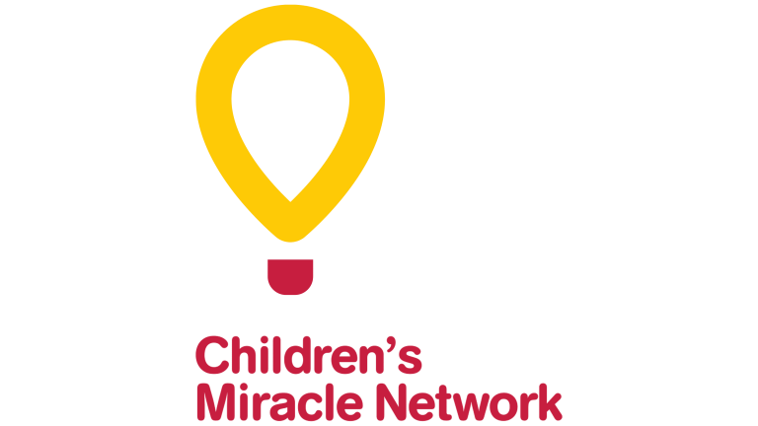
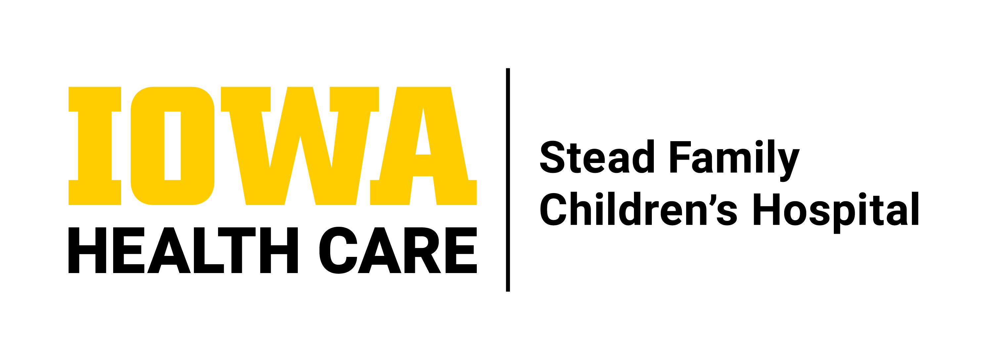
Preterm Birth and Multilingualism: Parental Beliefs and Early Language Exposure
Maria G. Thurow^{1,2}, Paige M. Nelson, MA^{1,3}, Ö. Ece Demir-Lira, PhD³, & Allison Momany, PhD¹
Department of Pediatrics – Neonatology¹, Department of Communication Sciences and Disorders², Department of Psychological and Brain Sciences³
University of Iowa
Introduction
Infants born preterm (<37 weeks gestational age) have a high risk of language delays, with nearly 40% diagnosed with a language deficit or disorder.²
Infants raised in multilingual environments achieve educational and social outcomes comparable to their monolingual peers.³
Many parents and caregivers believe that exposure to multiple languages could hinder their child’s development, which may lead them to limit multilingual exposure.⁴
Statistical Approaches:
Chi-square for categorical variables and t-test for continuous variables.
Normality of continuous variables assessed with Shapiro-Wilkes Test of Normality and Wilcoxon rank-sum test was used for non-normal continuous variables.
Figure 3. Individual-Level LENA Results at 6- & 12-Mo CA
Conclusions
No significant differences between mono- and multi-lingual families in:
Standardized language measures of infant language development.
Number of adult words, conversational turns , or child vocalizations in the home environment.
Parental perceptions of effect of multilingualism on child language development.
Results
Table 1. Demographics and Language
Pair | Language | GA –weeks | Birth weight - grams | Sex | Parental Education - Degree | Annual Family Income
1 | English, Serbo-Croatian | 31 | 2280 | M | Graduate or Professional | $300,000
 | English only | 32 | 2605 | M | Graduate or Professional | $70,000
2 | English, Spanish | 24 | 638 | F | Graduate or Professional | $96,000
 | English only | 23 | 660 | M | Graduate or Professional | $180,000
3 | English, Chinese | 33 | 2500 | F | Bachelor | $70,000
 | English only | 33 | 2830 | F | Bachelor | $149,000
4 | English, Arabic | 34 | 2525 | F | Graduate or Professional | $65,000
 | English only | 34 | 2030 | F | Graduate or Professional | $126,000
5 | English, Spanish | 28 | 1505 | M | Associate | $115,000
 | English only | 28 | 852 | F | Some college | $100,000
The objective of this study was to examine how parents of children from this at-risk population perceive multilingualism and to explore differences in home language environment and early language skills between monolingual and multilingual children.
Limitations
Small sample size
Overrepresentation of individuals with high levels of education and high income.
Table 4. SPEAK-R22 Questionnaire - Percentage of respondents who responded “Definitely not true”
Question | Timepoint | Multilingual (n=5) | Monolingual (n=5) | P value
It's a bad sign when toddlers start to mix up the different languages they are learning. | NICU 6mo CA 12mo CA | 40% | 20% | 1.0 1.0 1.0
 |  | 20% | 20%
 |  | 40% | 60%
When toddlers learn multiple languages at home, it will slow down their learning in all other subjects at school. | NICU 6mo CA 12mo CA | 80% | 40% | 0.52 0.17 1.0
 |  | 40% | 100%
 |  | 80% | 20%
A home environment with multiple languages makes it harder for toddlers to master each language. | NICU 6mo CA 12mo CA | 40% 40% 60% | 60% 100% 60% | 1.0 0.17 1.0
Learning multiple languages creates more drawbacks than benefits for toddlers. | NICU 6mo CA 12mo CA | 80% 60% 80% | 80% 100% 100% | 1.0 0.43 1.0
Clinical Implications
Multilingual exposure does not appear to hinder early language development in preterm infants
Results are consistent with other research suggesting that multilingual exposure does not negatively impact early language development.
Supporting multilingual families with accurate information may help reduce concerns about language delays.
Methodology
Participants:
Ten parents and their preterm-born children who received care in the University of Iowa Stead Family Children’s Hospital NICU.
Five multilingual (multi) and five monolingual (mono) children matched by gestational age, sex, parental education, and birth weight.
Parental Perspectives:
The Survey of Parents’/Providers’ Expectations And Knowledge (SPEAK-R22) questionnaire assesses parental beliefs and expectations about raising a multilingual child and was administered in the NICU and at 6- & 12-mo corrected age (CA).⁶
Likert scale with 4 options (definitely not true, probably not true, probably true, and definitely true).
Home Language Environment Analysis:
Families participated in Language Environment Analysis (LENA) recording days at 6- & 12-mo CA.
16-hour home auditory recordings captured: Adult Words, Conversational Turns, & Child Vocalizations.¹
Language Development Assessment:
At 12-mo CA, children completed the Bayley Scales of Infant and Toddler Development (Bayley-4). This assessment evaluates receptive and expressive language skills.⁵
Table 2. Average Bayley-4 Language Assessment Results at 12-mo CA
 | Multilingual (n=5) | Monolingual (n=5) | P value
Language standard score, mean ± SD | 95±12 | 100±11 | 0.527
Language percentile rank, mean ± SD | 39.0±27 | 49±27 | 0.582
*Other respondents rated the item as “Probably not true.”
Future Directions
Investigate long-term language outcomes in preterm multilingual children.
Examine potential shifts in parental beliefs as children develop.
Expand the sample size to improve generalizability and better understand individual differences
Figure 4. Individual-Level SPEAK-R22 Questionnaire Responses in the NICU and at 6- &12-mo CA
Figure 2. Individual-Level Bayley-4 Neurodevelopmental Assessment Results at 12-mo CA
References
Gilkerson, J., & Richards, J. (2020). A guide to understanding the design and purpose of the LENA® System.
Kwon, S. H., et al. (2015). Adaptive mechanisms of developing brain: Cerebral lateralization in the prematurely-born. NeuroImage, 108, 144–150.
McLeod, S., et al. (2016). Multilingualism and speech-language competence in early childhood: Impact on academic and social-emotional outcomes at school. Early Childhood Research Quarterly, 34, 53–66.
McLeod, S., et al. (2017). Tutorial: Speech assessment for multilingual children who do not speak the same language(s) as the speech-language pathologist. American Journal of Speech-Language Pathology, 26(3), 691–708.
Spencer-Smith, M. M., et al. (2015). Bayley-III cognitive and language scales in preterm children. Pediatrics, 135(5), e1258–e1265.
Suskind, D. L., et al. (2017). Development of the Survey of Parent/Provider Expectations and Knowledge (SPEAK). First Language, 38(3), 312–331.
Table 3. Average Language Environment Analysis (LENA) Results at 6- &12-mo CA
 | Multilingual (n=5) | Monolingual (n=5) | P value
6 month (CA)
Adult words (AW), mean | 19201±7422 | 15554±9305 | 0.513
Conversational turns (CT), mean | 503±196 | 293±192 | 0.125
Child vocalizations (CV), mean | 1625±412 | 1189±818 | 0.329
12 month (CA)
Adult words (AW), mean | 17367±6772 | 19674±18276 | 0.690
Conversational turns (CT), mean | 447±191 | 408±208 | 0.768
Child vocalizations (CV), mean | 1306±535 | 1467±295 | 0.579
Figure 1. Study schedule

