Slide 1

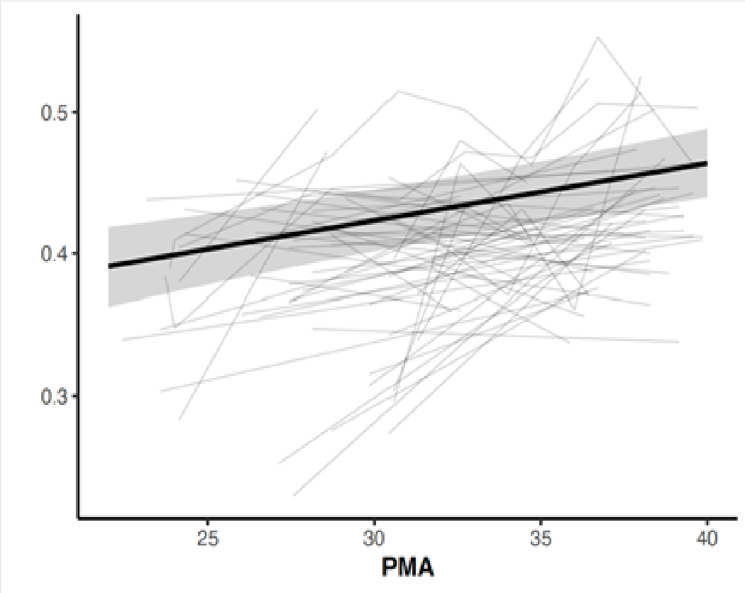
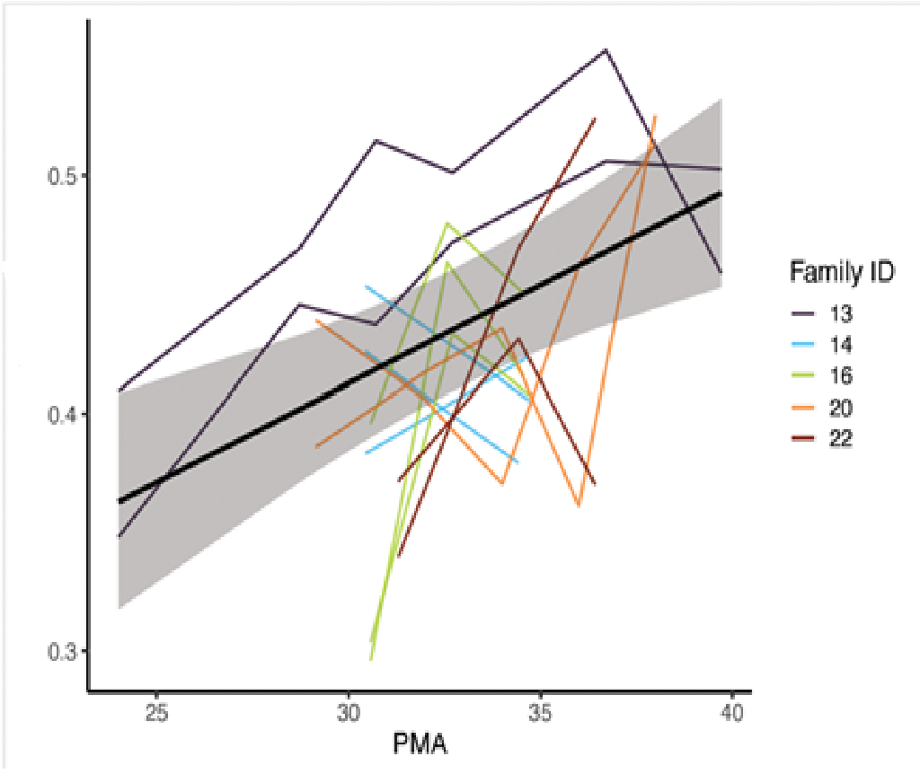
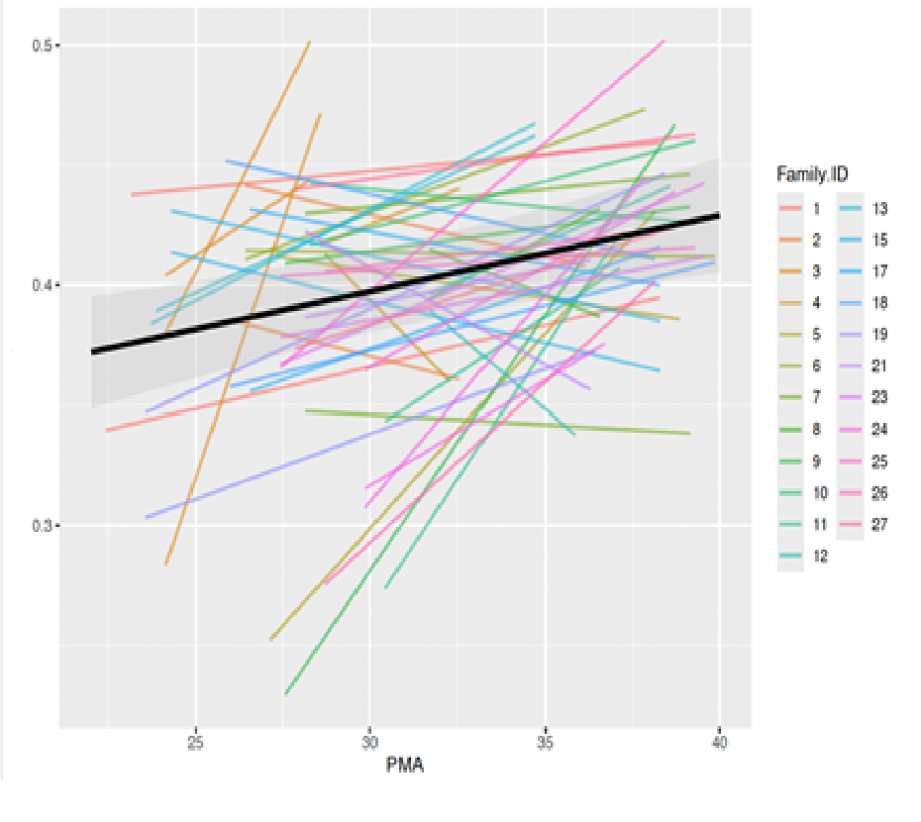
Epigenetic Signatures of Neonatal Stress:
Linking NICU Stress Exposure to DNA Methylation
DNA methylation changes related to neonatal morbidities
Fulden Aycan, MD¹, Lindsey Rhea, BS², Emma Simpson, MS², Laura Jelliffe-Pawlowski, PhD, MS³, Elizabeth E. Rogers, MD⁴, John M. M. Dagle, MD, PhD¹, Kelli Kae Ryckman, PhD⁵, Allison Momany, PhD¹
¹ University of Iowa Stead Family Children’s Hospital, Iowa City, IA, USA, ² University of Iowa Roy J. and Lucille A. Carver College of Medicine, Iowa City, IA, USA, ³ New York University, New York, NY, USA, ⁴
University of California, San Francisco, School of Medicine, San Francisco, CA, USA, ⁵ Indiana University, Bloomington, IN, USA
Introduction
Results
Summary
Very preterm infants (VPT; <32 weeks) experience significant NICU-related stress from medical procedures and illness —contributing to adverse neurodevelopmental outcomes.
DNA methylation (DNAm), an epigenetic mechanism, may link early-life stress to lasting biological changes.
Prior work evaluating DNAm associated with neonatal morbidities used samples at discharge, limiting the ability to distinguish whether changes precede or result from neonatal morbidities.
Table 1: Infant Demographic and Clinical Characteristics
Figure 1: Number of Infants with no, 1, 2, 3, or 4 of the 4 serious morbidities
DNA methylation in VPT infants demonstrates dynamic longitudinal changes associated with developmental maturity (PMA), while associations with cumulative neonatal morbidity are limited after adjustment for multiple testing.
Variable | Mean (SD) or n (%)
Gestational age, weeks | 24.5 (2.6)
Birth weight, grams | 1067.3 (445.4)
Male sex | 36 (62)
Monozygotic twins | 14 (24)
Dizygotic twins | 32 (55)
Trizygotic triplets | 12 (21)
Bronchopulmonary dysplasia (BPD) | 44 (75)
Retinopathy of prematurity (ROP) | 19 (32)
Serious brain injury | 4 (7)
Infection | 14 (24)
Limitations
This study had a small sample and only included twins and triplets, which may limit generalizability.
Using a candidate CpG approach and a composite morbidity score may have missed other important DNA methylation changes.
Objectives
Note. Brain injury includes severe IVH or PVL; infection includes sepsis, NEC, or meningitis; BPD defined as oxygen need at 36 weeks PMA.
To investigate how serious neonatal morbidities influence epigenetic programming in VPT infants.
Aim: Assess DNAm changes related to serious neonatal morbidities across NICU hospitalization.
Table 2:Associations Between CpG Methylation, PMA, and Clinical Factors in VPT Infants
 |  |  |  | PMA |  |  | Clinical Factors
CpG site | Gene Annotation | Random Effects (Var, SD) | Residual Var | Estimate | SE | p-value | Estimate | SE | p-value
cg06343740 | HPS4; SRRD | 0.000064, 0.008 | 0.00235 | 0.0043 | 0.0008 | <0.001 | 0.0105 | 0.0038 | 0.009
cg08303167 | Intergenic | 0.0, 0.0 | 0.000533 | 0.0008 | 0.0004 | 0.033 | 0.0025 | 0.0017 | 0.153
cg09787236 | Intergenic | 0.0, 0.0 | 0.00273 | 0.0012 | 0.0009 | 0.209 | 0.0010 | 0.0039 | 0.792
cg11255857 | TNS3 | 0.00006, 0.008 | 0.000384 | -0.0001 | 0.0003 | 0.771 | -0.0004 | -0.0018 | 0.818
cg12861771 | TMEM266 | 0.0, 0.0 | 0.000376 | 0.00112 | 0.0003 | 0.001 | 0.0024 | 0.0015 | 0.010
cg24517837 | TENM2 | 0.0008, 0.03 | 0.00195 | 0.00469 | 0.0008 | <0.001 | 0.0024 | 0.0051 | 0.636
Methodology
Future Directions
Population: VPT infants. Excluded: Known genetic syndromes, congenital anomalies, or lack of English-language consent.
Sample Collection: Dried blood spots obtained at birth and serially until discharge.
Clinical Outcomes: Major neonatal morbidities: Bronchopulmonary dysplasia (BPD). Retinopathy of prematurity (ROP), Serious brain injury, Infection.
Epigenetic Analysis: DNA isolated from dried blood spots and DNAm measured using Illumina EPIC v2.0 array.
Analytic Approach: Focused on loci previously associated with neonatal morbidity (Evers, 2020). Applied linear mixed-effects models to account for repeated measures.
Future studies should replicate these findings in larger, more diverse cohorts.
Integration of longitudinal DNAm with other omics and clinical data.
Consider timing and severity of individual morbidities.
Standardizing sampling and linking early DNAm to neurodevelopmental outcomes may reveal key epigenetic mechanisms and their potential as biomarkers or intervention targets.
Note. Values are presented as unstandardized estimates (SE). Models were adjusted for relevant covariates array and relatedness (siblings)
Figure 2: cg06343740_BC21 all individuals
Figure 3: Individuals with complete sampling (≥3 time points) for cg06343740_BC21
Figure 4: Individuals with only two samples (near birth and near discharge) for cg06343740_BC21
Funding
National Institute of Health R00HD110605-03 (PI: Allison Momany, PhD)

