Slide 1


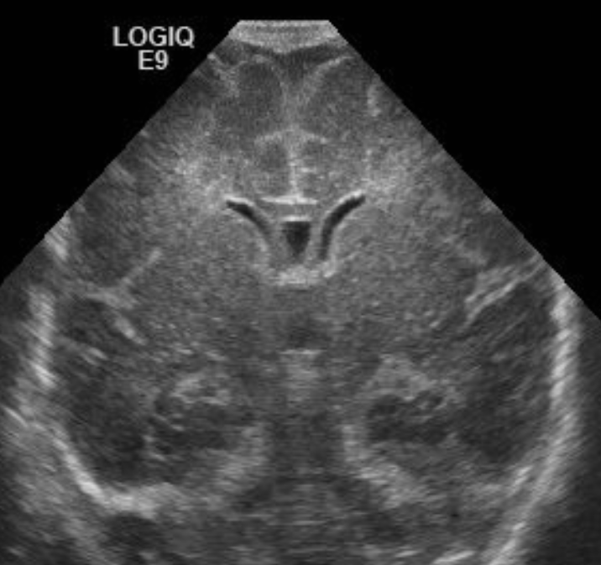
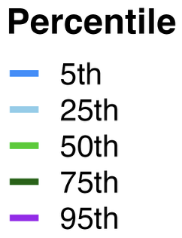

2D Head Ultrasonography Reference Values for Extra-Axial Fluid Spaces in Extremely Preterm Neonates
Paige M. Nelson, PhD, Allison M. Momany, PhD, Heidi M. Harmon, MD, MS
Department of Pediatrics, Division of Neonatology, University of Iowa Healthcare Stead Family Children’s Hospital, Iowa City, Iowa, USA
Background
Measurements & Analysis
Table 3. HUS Measurements at ~DOL 7 and 36-Weeks PMA by Gestational Age at Birth
DOL 7
HUS Metric | All (N=272) | Gestational age at birth (weeks)
 |  | 22 weeks (n=18) | 23 weeks (n=35) | 24 weeks (n=48) | 25 weeks (n=72) | 26 weeks (n=99)
IHW | 0.0 (0.0–0.6) | 0.0 (0.0–0.0) | 0.0 (0.0–0.4) | 0.0 (0.0–0.4) | 0.0 (0.0–0.7) | 0.0 (0.0–0.8)
SCW | 0.0 (0.0–0.9) | 0.0 (0.0–0.0) | 0.0 (0.0–0.9) | 0.0 (0.0–0.9) | 0.0 (0.0–1.2) | 0.0 (0.0–0.8)
CCW | 0.0 (0.0–0.0) | 0.0 (0.0–0.0) | 0.0 (0.0–0.0) | 0.0 (0.0–0.0) | 0.0 (0.0–0.0) | 0.0 (0.0–0.0)
AHW | 1.9 (1.4–2.5) | 1.9 (1.5–2.5) | 2.1 (1.6–2.7) | 1.7 (1.4–2.3) | 2.0 (1.4–2.5) | 1.9 (1.4–2.4)
VI | 8.4 (7.8–9.0) | 8.0 (7.4–8.4) | 8.1 (7.6–8.7) | 8.0 (7.8–8.6) | 8.8 (8.1–9.2) | 8.6 (8.0–9.1)
36 Weeks PMA
IHW | 1.9 (1.3–2.7) | 0.0 (1.1–2.4) | 0.0 (0.9–2.4) | 0.0 (1.2–3.0) | 2.6 (1.5–2.9) | 0.0 (1.3–2.6)
SCW | 3.5 2.5–4.6) | 4.1 (2.5–4.5) | 3.3 (2.5–4.2) | 3.8 (2.9–4.8) | 3.7 (3.0–4.6) | 3.0 (2.1–4.2)
CCW | 2.3 (1.3–3.5) | 2.3 (1.6–4.0) | 2.5 (1.6–3.6) | 2.9 (1.2–3.9) | 2.5 (1.6–3.3) | 1.9 (0.6–2.9)
AHW | 2.5 (1.8–3.1) | 2.6 (2.1–3.5) | 2.7 (2.3–3.6) | 2.5 (1.9–2.7) | 2.5 (1.9–2.7) | 2.4 (1.8–3.1)
VI | 10.8 (10.2–11.7) | 11.5 (10.5–12.9) | 11.3 (10.6–12.3) | 10.6 (10.2–11.4) | 11.4 (10.0–11.8) | 10.6 (10.0–11.5)
Risk of developmental impairments is highest among extremely preterm (EP; <28 weeks of gestation) neonates, due to brain insults and dysmaturation
Prominent extra-axial space and ex-vacuo ventricular dilatation on brain imaging are markers of white matter injury or dysmaturation
HUS Exams: Linear measurements of CSF spaces conducted on previously collected clinical HUS exams taken ~DOL 7 & ~36 weeks PMA
C
B
A
Interhemispheric width (IHW): Widest horizontal distance between the left and right hemispheres
Sinocortical width (SCW): Shortest distance between lateral wall of the triangular superior sagittal sinus and the surface of the adjacent cerebral cortex
Craniocortical width (CCW): Shortest vertical distance between the calvarium and the surface of the cerebral cortex
Anterior Horn Width (AHW): Distance between the medial wall and floor of the lateral ventricle at the widest point
Lateral Ventricular Index (VI): Distance between the most lateral wall of the anterior horn and falx
E
A
B
D
Survival to Discharge by Gestational Age at University of Iowa’s
Stead Family Children’s Hospital:
C
Critical Knowledge Gaps:
Reference values of extra-axial fluid spaces by gestational age in EP neonates have not been established
Current normative ventricular metrics are only established for ≥24 weeks
D
E
Figure 1. HUS obtained through the anterior fontanelle in the coronal plane at the level of the foramen of Monro and the 3rd ventricle at 36 weeks PMA.
Statistical Analysis Plan:
Percentiles were computed and locally estimated scatterplot smoothing (LOESS) was applied to visualize the effect of GA at the time of scan
Generalized additive models were utilized to examine potential sex differences in curves before plotting
Results
Note. Values (mm) are presented as median (IQR; Q1-Q3), where Q1 represents the 25th percentile and Q3 the 75th percentile.
Study Objective
Use two-dimensional (2D) head ultrasonography (HUS) metrics to establish cerebrospinal fluid (CSF) space reference values at day of life (DOL) 7 and 36-weeks postmenstrual age (PMA) in neonates born at 22 to 26 weeks of gestation.
Study Population
Inclusion Criteria:
Gestational Age: 22 0/7 – 26 6/7 weeks
Birth years: 2006 – 2019
Hospital: Level IV NICU in University of Iowa Healthcare Stead Family Children’s Hospital, Iowa City, Iowa, USA
Clinical data extracted prospectively as part of NICHD Neonatal Research Network General Database Study
Exclusion Criteria:
Postnatal moderate-to-severe brain injuries (e.g., periventricular or grade III intraventricular hemorrhage, cystic periventricular leukomalacia)
In-utero atrophy suggestive of perinatal insult at DOL 7:
  Enlarged extra-axial space (Sinocortical width >3.5mm)
  Ex-vacuo dilatation (Anterior horn width >4.0mm)
Table 1. Maternal/Infant Demographics and Clinical Characteristics (N=272)
Maternal Factors | M ± SD | Infant Factors | M ± SD
Multiple birth, n (%) | 81 (30) | GA, weeks | 24.7 ± 1.3
Chorioamnionitis, n (%) | 47 (18) | Birth weight, grams | 737 ± 173
Antenatal steroids, n (%) | 261 (96) | Birth head circumference, cm | 22.6 ± 1.9
Cesarean section, n (%) | 228 (84) | Female, n (%) | 141 (52)
Private medical insurance, n (%) | 153 (56) | APGAR, 5-minute | 6.8 ± 1.5
High school diploma, n (%) | 168 (62) | Retinopathy of prematurity, n (%) | 167 (61)
White, n (%) | 218 (80) | Patent ductus arteriosus, n (%) | 206 (76)
Black, n (%) | 34 (12) | Bronchopulmonary dysplasia, n (%) | 145 (53)
Hispanic Ethnicity, n (%) | 18 (7) | Early/late onset septicemia, n (%) | 64 (23)
Figure 2. LOESS-smoothed percentile growth curves for extra-axial and ventricular measurements obtained from HUS scans. Panels A–F show extra-axial measurements: IHW (A, B), SCW (C, D), and CCW (E, F) at DOL 7 and 36 weeks PMA, respectively. Panels G–J show corresponding ventricular measurements: AHW (G, H) and and right VI (I, J) at the same two time points. Shaded areas indicate percentile ranges: dark grey represents the interquartile range (25th–75th percentiles), and light grey represents the 5th–95th percentile range. Solid lines depict smoothed percentile curves, and black points indicate individual raw measurements.
Conclusions
Future Directions
Funding
EP neonates born at 22–23-weeks trend toward larger ventricular size (VI and AHW) at 36 weeks PMA compared to 24–26-week neonates
LOESS curves at ~36 week PMA showed substantial variation among EP neonates, despite excluding neonates with significant brain insults
Constructed percentile curves provide clinicians a tool to evaluate if extra-axial space measures are in the expected range for EP neonates at ~36 weeks PMA
No significant sex differences observed for any HUS metrics
Identify clinical measures most strongly associated with progressive enlargement of extra-axial spaces
Determine whether linear HUS measurements predict developmental sequalae
NICHD Neonatal Research Network (UG1HD053109)
NIMH, Iowa Neuroscience Specialty Program in Research Education (UI Institutional Postdoctoral Research Training Program; T32MH019113)
Note. Bronchopulmonary dysplasia was measured using the Jensen et al. 2019 criteria, based on the mode of respiratory support at 36 weeks PMA, regardless of previous supplemental oxygen use. Severity of bronchopulmonary dysplasia is unavailable for 17 infants due to reasons such as discharge or transfer before 36 weeks PMA. Parity includes the current pregnancy.

