Slide 1
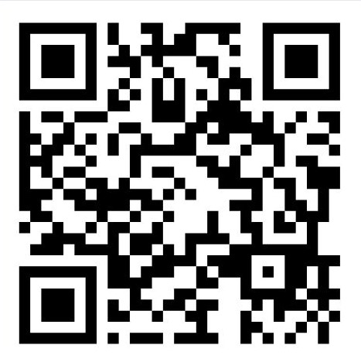


Do Bayley screening test scores at 0-18 months predict full Bayley test scores at 18-31 months in High-Risk Infants?
NEST Lab
Narjes Ashouri Mirsadeghi, MS, Paige M. Nelson, PhD, & Allison M. Momany, PhD
Department of Pediatrics, University of Iowa, Iowa City, Iowa
Introduction
Results
Summary
Survival rates of high-risk infants (e.g., very preterm birth, hypoxic-ischemic encephalopathy, congenital heart disease) have increased in recent years
These infants remain at higher risk for neurodevelopmental impairments
The Bayley scales of Infant and Toddler Development Screening Test (Bayley-III/IV) is commonly used early in life
The Full Bayley-III/IV assessment is a more comprehensive diagnostic tool for evaluating neurodevelopmental outcomes
Cognitive
Receptive
Communication
Expressive
Communication
Fine Motor
Gross Motor
Normative
sample
Figure 1. Bayley Screening risk categories by domain and age at testing date (n = 51). The y-axis depicts the percentage of children in each risk category. The x-axis reflects the age groups for each domain. The black bar on the right-hand side of the figure depicts the expected percentage of children in each risk category according to the normative sample.
This study evaluated whether early Bayley screening scores predict later full Bayley score
Screening scores demonstrated limited predictive value for subsequent cognitive, language, and motor outcomes
A moderate correlation was only observed in fine and gross motor domains at 7–9 months
Early screening alone may not be sufficient for identifying long-term developmental outcomes in high-risk infants
The study had a small sample size and a retrospective design which limited the control over timing and consistency of assessments
2% High Risk
23% Borderline
% of children in each risk category
75% Low Risk
A: 16 day - 3 month, 30 day ​B: 4month - 6 month, 30 day ​C: 7 month - 9 month, 30 day D: 10 month - 13 month, 30 day E: 14 month -17 month, 30 day
Low Risk
Borderline
High Risk
Objective
I
II
III
IV
V
Do Bayley screening tests administered early in life predict later comprehensive Bayley scores in infants with medical conditions that increase the risk for neurodevelopmental impairments?
Full Bayley
Methodology
Study design: Retrospective study of infants who were born between 2020–2023, cared for in the NICU at Stead Family Children’s Hospital, and seen in the Neonatology Follow-up Clinic
Participants: 51 infants with Bayley screening tests (16 days–18 months) and full Bayley assessments (18–31 months)
Bayley screening results were categorized into five age groups based on Bayley screening manual cut-score norms (0:16–3:30, 4:00–6:30, 7:00–9:30, 10:00–13:30,14:00–17:30)
VI
VII
VIII
IX
X
Full Bayley
Future
Directions
Figure 2. Correlations between Bayley screening domain scores (I-V: Cognitive, VI-X: Gross Motor ) and full Bayley composite scores at 18-31 months. No significant correlation between the screening scores and full Bayley scores were observed, except for fine and gross motor in infants 7:00-9:30 months, which demonstrated a moderate correlation (R=0.47 and 0.61, respectively).
Larger prospective studies to improve statistical power
Evaluation of the benefits of administering an early comprehensive assessment (full Bayley) for more accurate and reliable prediction of future neurodevelopmental outcomes
Consideration of clinical risk factors with screening results to enhance early identification of neurodevelopmental delays
Analysis: Pearson correlation was used to examine associations between Bayley screening domains (cognitive, receptive/expressive communication, fine/gross motor) with full Bayley cognitive, language, and motor composite scores
Screening-Cognitive
Screening-Receptive Communication
Screening-Expressive Communication
Screening- Fine Motor
Screening-Gross Motor
Table 1. Infant characteristic (n=51) |  | Mean ± SD
 | Gestational age, weeks | 28.59 ± 6.55
18-31 Month | Bayley Cognitive Composite Bayley Language Composite Bayley Motor Composite | 91.67 ± 17.66 90.17 ± 20.73 88.40 ± 13.48
% of children
Figure 3. Associations of Bayley screening cognitive, language (receptive/expressive communication) and motor (fine and gross) score categories with corresponding Full Bayley score categories. Each chart presents the percentage of infants falling into each full Bayley score category at corrected age of 18-31 months in relation to Bayley screening score categories at 14 month -17 month, 30 day corrected age across each domain. Results are not shown for other age groups. Full Bayley Scores: <70 70-84 85-100 >100

